Slide 1
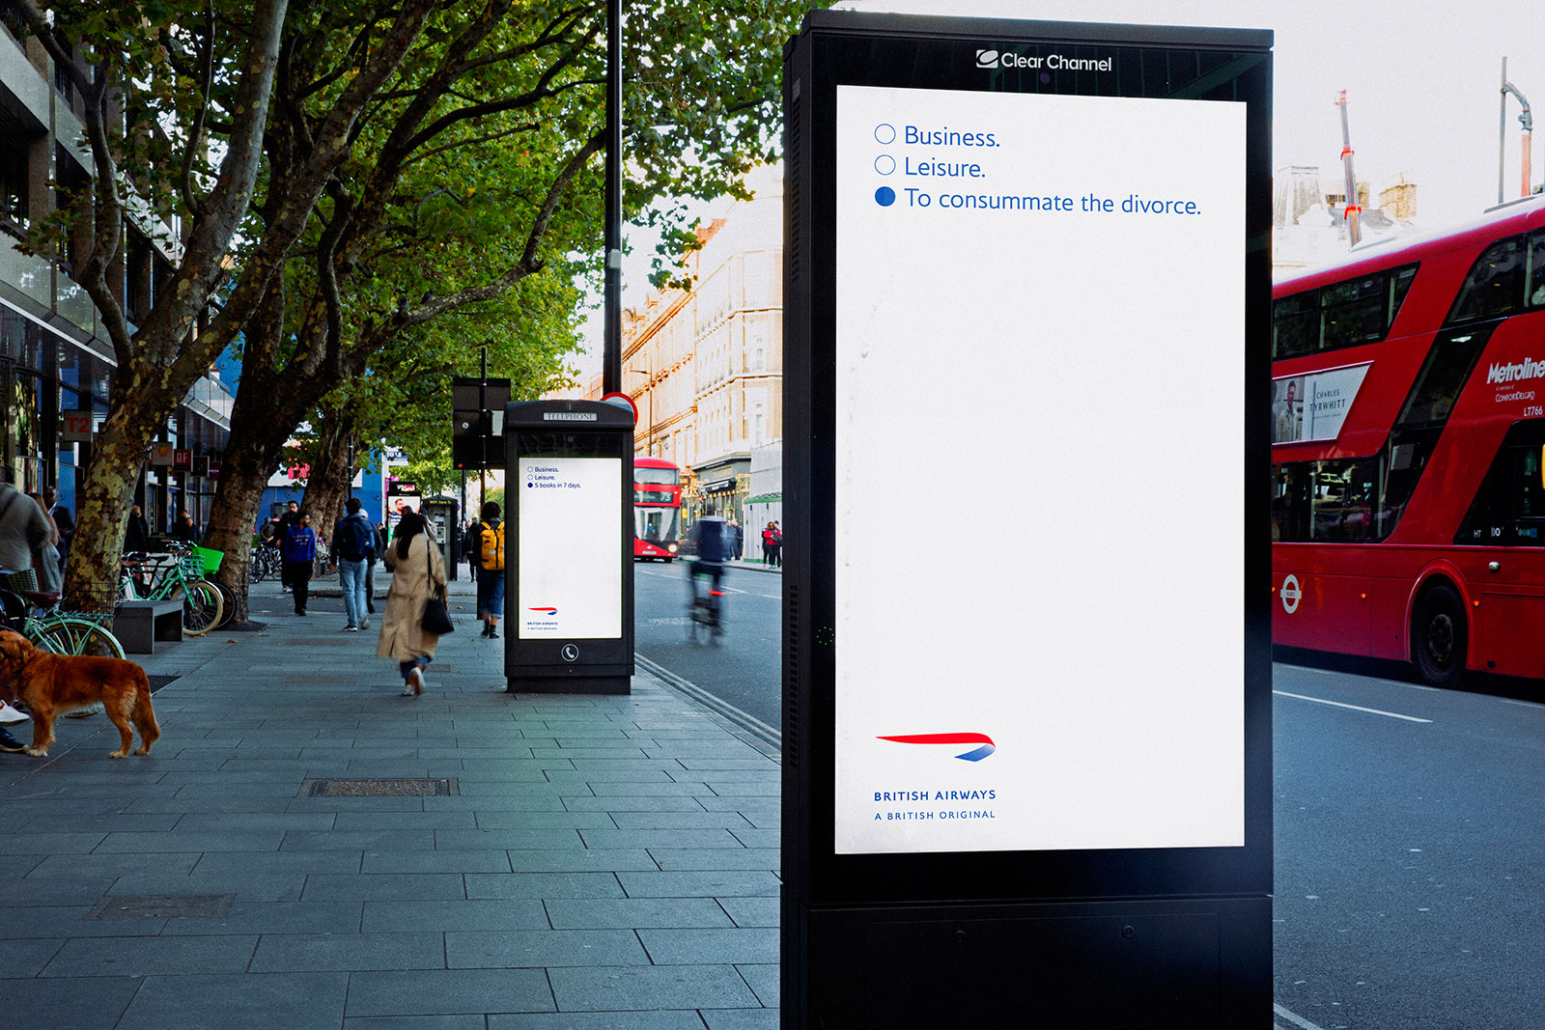
PREDICTIVE MODEL ON BRITISH AIWAYS CUSTOMER BOOKING BEHAVIOUR

Slide 2
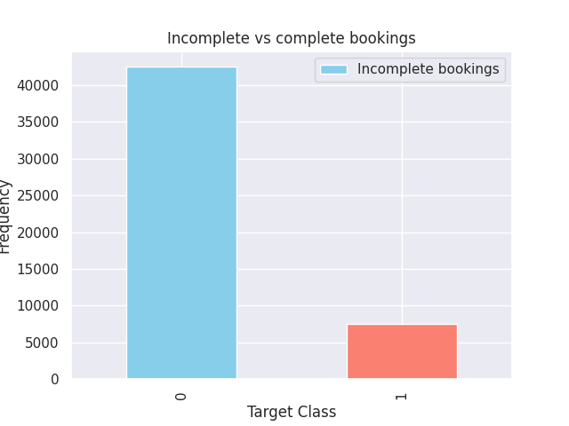

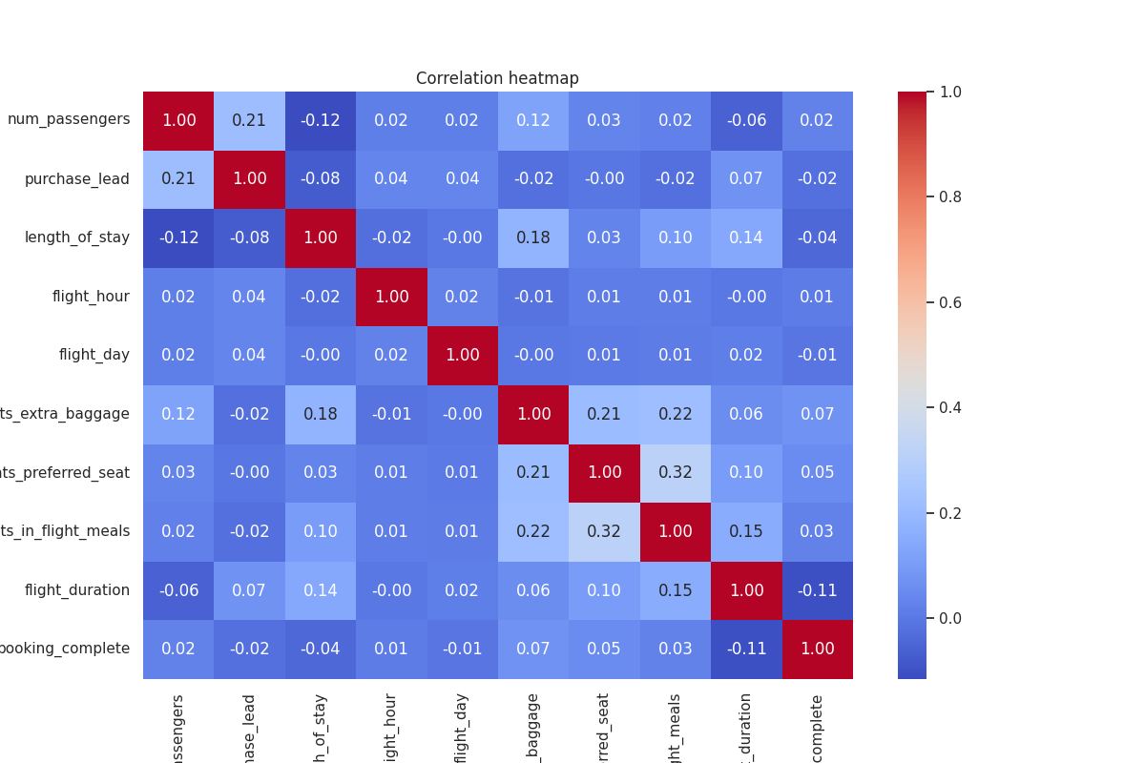
Summary of Customer Booking Behaviour Data
The table above provides a detailed breakdown of the model’s performance.
While prediction accuracy for incomplete bookings is relatively high (~90%), the model struggles with predicting completed bookings, achieving only about 50% accuracy. This suggests that the model is not reliably identifying patterns associated with booking completion, likely due to dataset imbalance.
Additionally, correlation analysis indicates weak relationships between most feature variables and the target class, highlighting potential limitations in the dataset’s predictive capability. Given these findings, expanding the dataset to include additional relevant features should be considered to enhance model performance and improve predictive accuracy in future iterations.
The dataset comprises 50,000 records, with approximately 15% representing completed bookings and the remaining 85% representing incomplete bookings.
This significant disparity introduces a class imbalance, which can negatively impact the model's accuracy and predictive reliability.

